Slide 1
COMP 5620/6620
User Interface Design and Evaluation

Slide 2
Course Introduction
Welcome to COMP 5620/6620
Syllabus
Introduction

Slide 3
Good Design (our goal!)
“Every designer wants to build a high-quality interactive system that is admired by colleagues, celebrated by users, circulated widely, and imitated frequently.” (Shneiderman, 1992, p.7)
…and anything goes!…

Slide 4
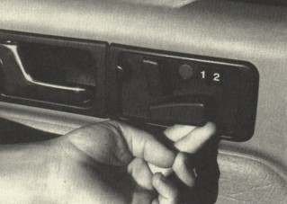
The Good…

Slide 5
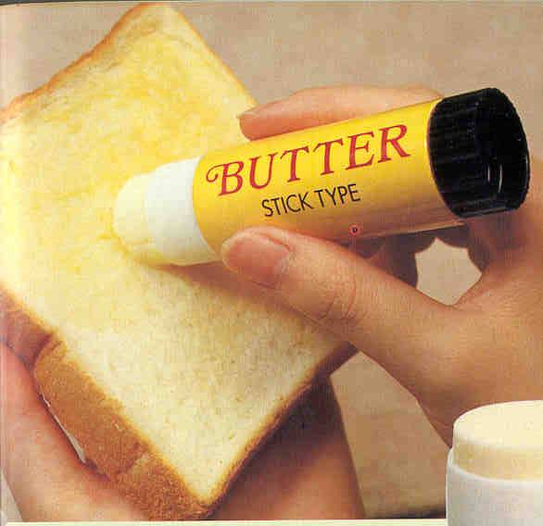
The Good…

Slide 6
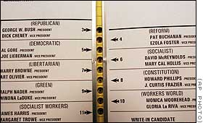
The Bad…

Slide 7
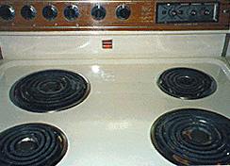
The Bad…

Slide 8

The Good…

Slide 9

The Bad…

Slide 10
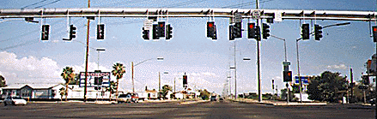
The Ugly…
http://www.awwwards.com/

Slide 11

The Good…

Slide 12
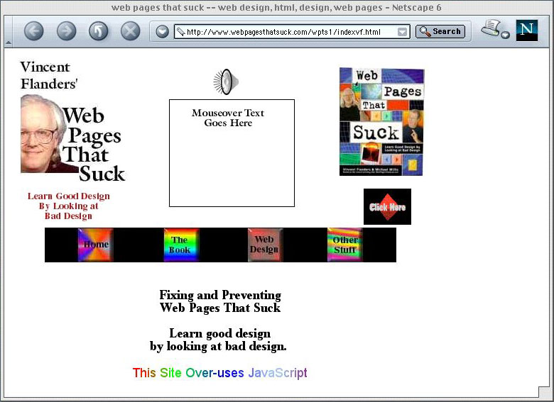
The Ugly…

Slide 13
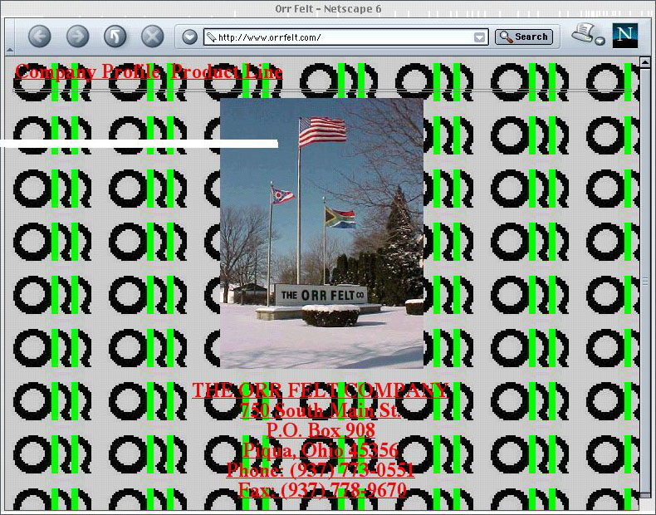
The (really) Ugly…

Slide 14

What The…???

Slide 15
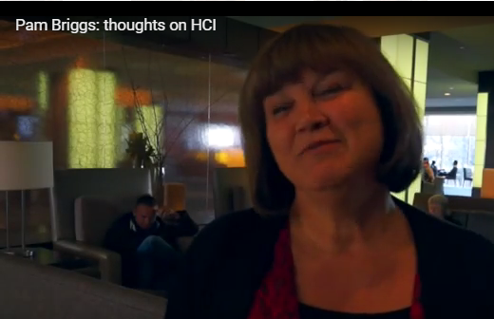
The Future of Design & HCI
The University of Trier in Germany

Slide 16
But What Makes it Good?!
Functionality
Speed & efficiency
Reliability, security, data integrity
Standardization, consistency
USABILITY !

Slide 17
Closer to Fine: A Philosophy
…The human user of any system is the focus of the design process. Planning and implementation is done with the user in mind, and the system is made to fit the user, not the other way around….
Bruce Walker
Georgia Institute of Technology

Slide 18
User Interface Design Is …
Built for humans; must be designed for the user
Recognize individual differences; appreciate design implications of these factors
Recognize the design of things, procedures, etc., influences human behavior and well-being
Emphasize empirical data & evaluation
Rely on the scientific method
Things, procedures, environments, and people do not exist in isolation

Slide 19
User Interface Design Is Not…
NOT just applying checklists and guidelines
  These can help, but UID is a whole philosophy
NOT using oneself as the model user
  Know your real users; recognize variation in humans
NOT just common sense
  Knowing how to design a fire alarm so it will be heard over background noise is not something we all know.
  The UI specialist knows where or how to get the information needed to answer design questions

Slide 20
What Are the Key “Factors”?!
“It Depends…”
  Physical factors
  Perceptual factors
  Cognitive factors
  Social factors
  Historical factors
…they ALL can affect design!

Slide 21

How Do You Know It’s Good?!
Usability Test and Evaluation
We will get to this later.

Slide 22

User Interface
What is the User Interface?
  To Users, the interface is the system.

Slide 23
User Interface
What is the User Interface?
  If you build a system that is not usable, then who will use it?

Slide 24
User Interface
What is the User Interface?
  For today’s users, communication with the system has become at least as important as computation by the system.
  Computation is always faster than communication.

Slide 25
User Interface
What is the User Interface?
  48% to 100% of code supports the user interface. (This is increasing)
  Computer scientists view interface as NOT an integral part of software.
    Software function Rules All.

Slide 26
User Interface
What is the User Interface?
  The communication medium between the user and the system.

Slide 27
User Interface
User?!
  Attorneys have clients.
  Doctors have patients.
  Teachers have students.
  Managers have customers.
  Researchers have subjects.
Drug addicts are Users.
  Why do we refer to our clients as users?

Slide 28
Discussion #1
Due Date, August 23
Add to Canvas Discussion and discussion will be graded work.
We will share discussions in Class Next week.

Slide 29
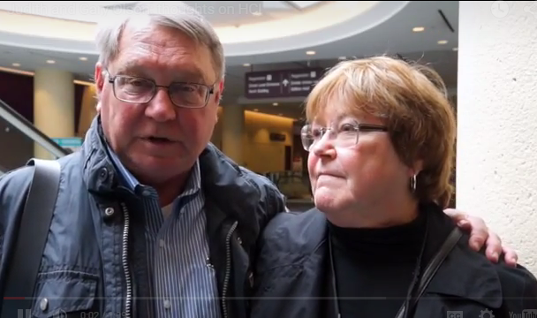
Thoughts on Design & HCI
Judith and Gary Olson - Thoughts on HCI
Judith and Gary Olson - Thoughts on HCI
Judith and Gary Olson

